Slide 1
Series 1 Wireless Projector Setup Commons MMS
Technology Team

Slide 2
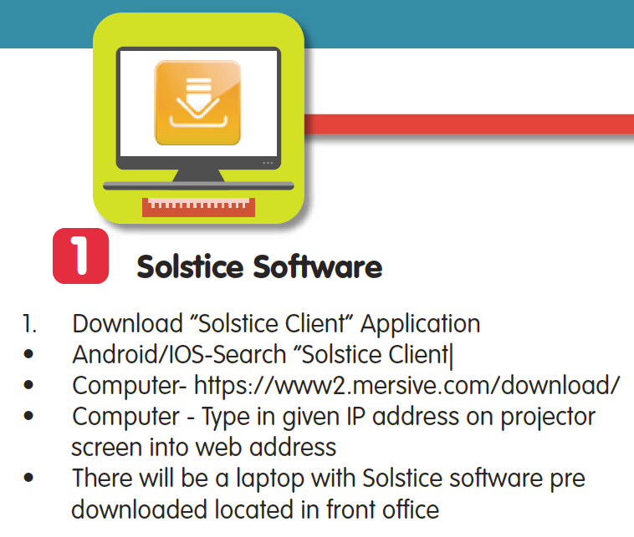
Step 1 – Software

Slide 3
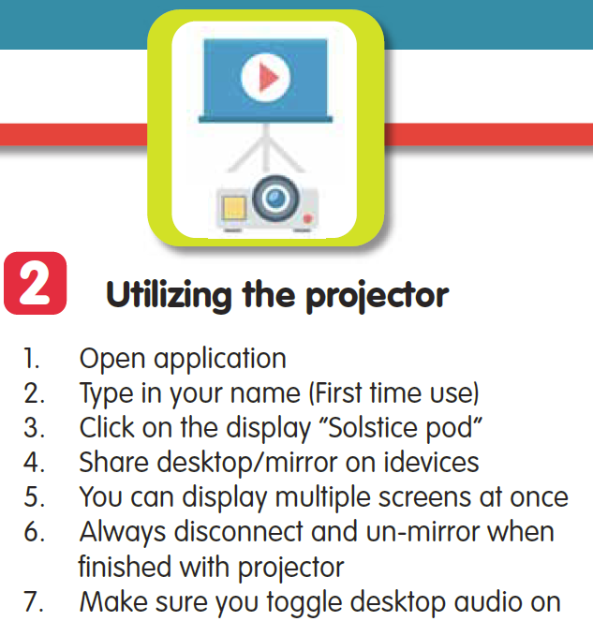
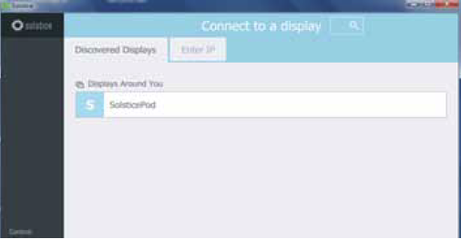
Step 2 – Connection

Slide 4
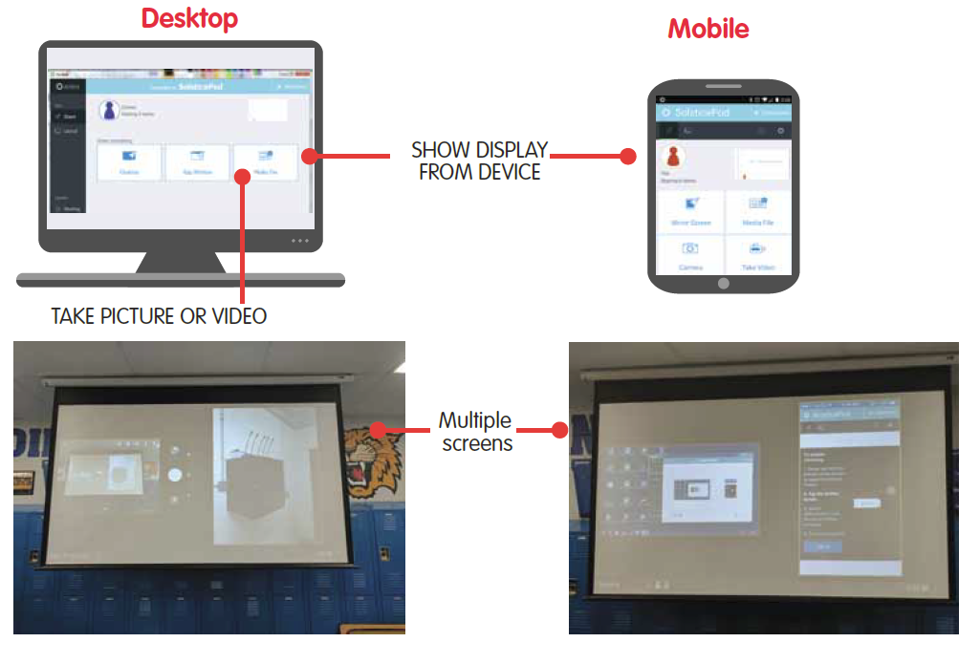
Displays

Slide 5
Step 3 – Microphone

Slide 6
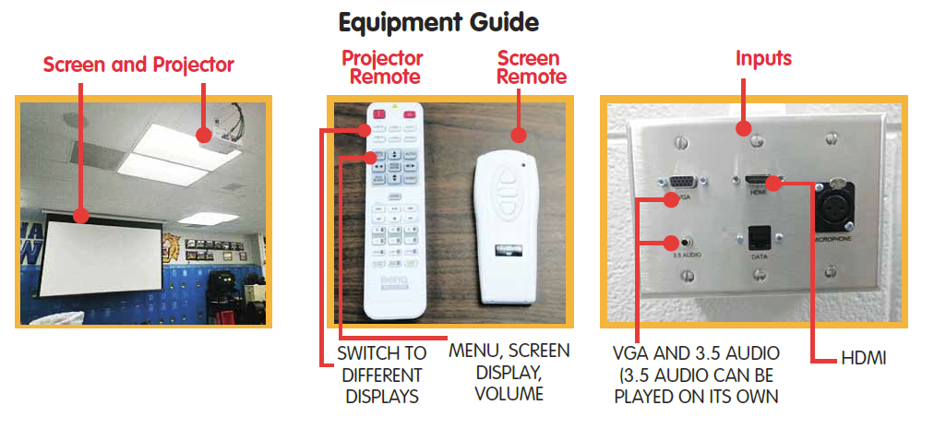
Equipment

Slide 7
Step 4 - Operation

Slide 8
Important
Friendly Reminder
Remember to check out and return equipment (Remotes, microphones, cords, or the laptop) to the main office.

