Slide 1
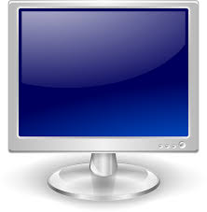
HOW TO Use DISPLAY BOARD
Medinah District 11

Slide 2
Type in URL and Login
Receive URL and password from administrator

Slide 3
Create and Schedule
Create - Make slides and playlists Schedule - What time you want those playlists to start

Slide 4
Create
Playout - Design a slide New Playlists – Combine slides

Slide 5
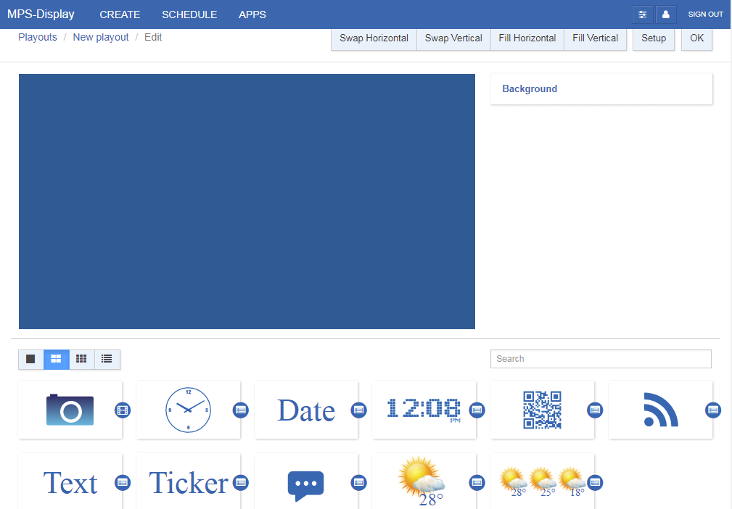
Playout
Press a new playout
Pick a theme
Press edit to add any specifics
Other icons to choose from are clock, date, time, QR code, and input text, ticker of information to put on bottom or top of screen.

Slide 6
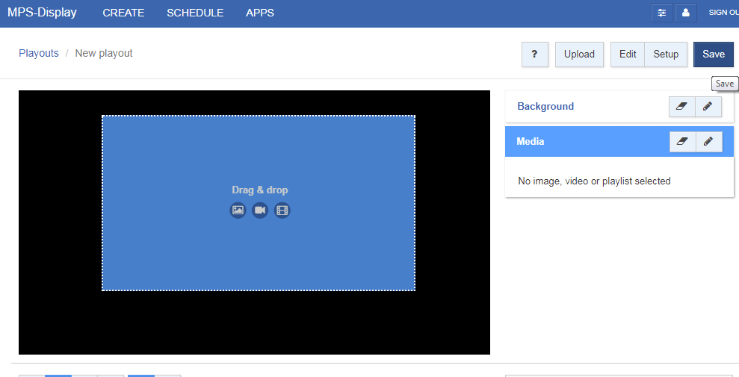
Playout Image
Drag image icon from below to screen
When inputting image make sure you match the correct dimensions on screen
You can always use “paint” to resize image by clicking on the button resize
Click Save

Slide 7
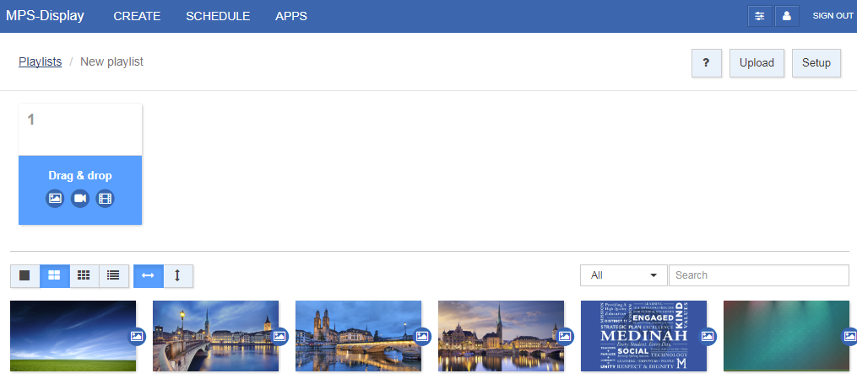
New Playlist
Press new playlist
Drag slides from below to “drag and drop” screen in the order you want
Save playlist

Slide 8
Home Screen Icons
The icons will be labeled differently to show what you have uploaded or created (Playout image (Slide made), Playlist image (Slideshow made), and picture image (Picture uploaded))

Slide 9
Edit Playlist Timing
Press the playlist you would like to edit
Setup and type in amount of seconds you would like to display image on board
You can also adjust order

Slide 10
Scheduling
Click Scheduling at the top to set up a timeframe
Click the playlists dropdown to choose your playlist
Drag and drop into schedule or default for the display timeframe

